Slide 1
Name- Ishita Agarwal Reg No-21BCE5060 School-SCOPE

Slide 2
Experiences:-
INTERNSHIP ON WEB DEVELOPMENT (Internship-studio)
• Learned about HTML, CSS, and JavaScript
• Made a fully functional website and made many forms and web page
Programming foundations with JavaScript, HTML, and CSS (with honors) from Coursera.
LinkedIn assessment badge in Python, Java, JavaScript, XML, CSS, FrontEnd development, HTML, OOPs, C, and C++

Slide 3
Projects:-
Last Moment Ticket Cancelling and Booking System
• Webpage is built to take data from those who want to book tickets after tickets are full and stored in a database with HTML, CSS, Python, and MySQL.
• It also takes data from those who want to cancel and thus full refund can be given by giving a ticket to that person who wants to cancel.
Python is connected with html and then data will be taken from form.
Another webpage for those who want to cancel ticket is created which shows if anyone wants ticket of that train by searching from database.
Ticket will be cancelled of that person and given to that person who first filled form (those who want ticket)

Slide 4
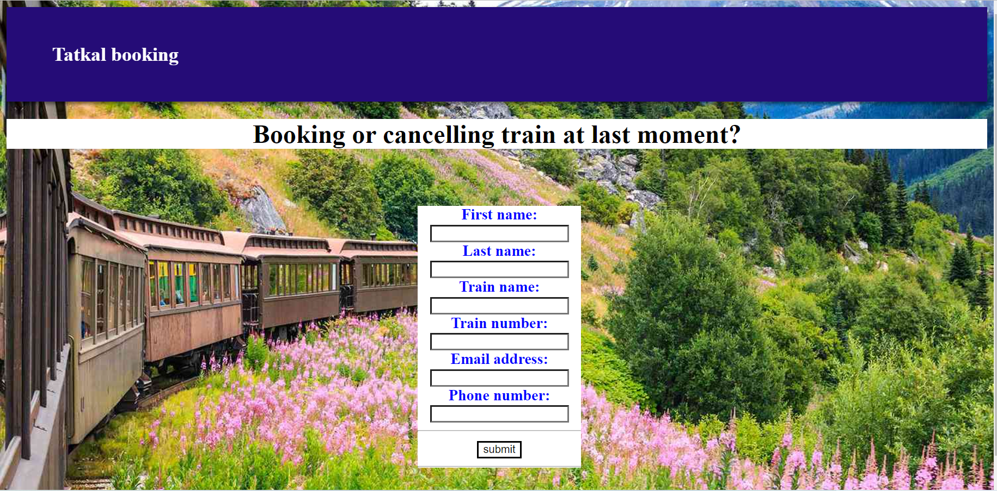
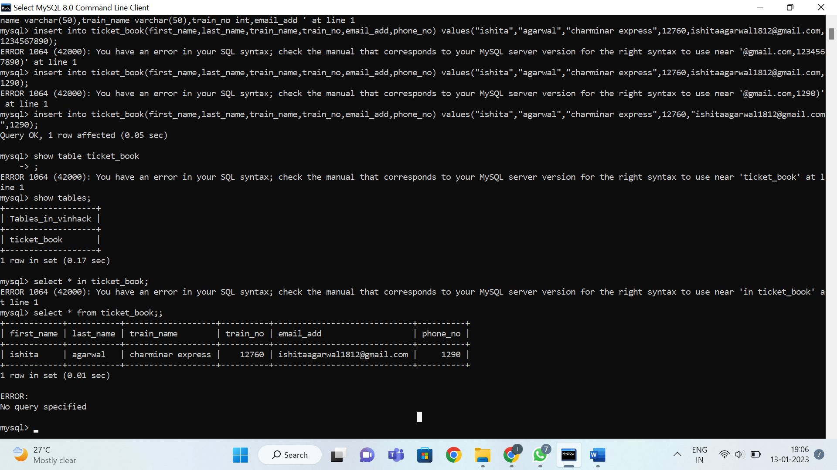
To take data from user who wants ticket.
Python is connected to mysql to take data
Data stored in mysql

Slide 5
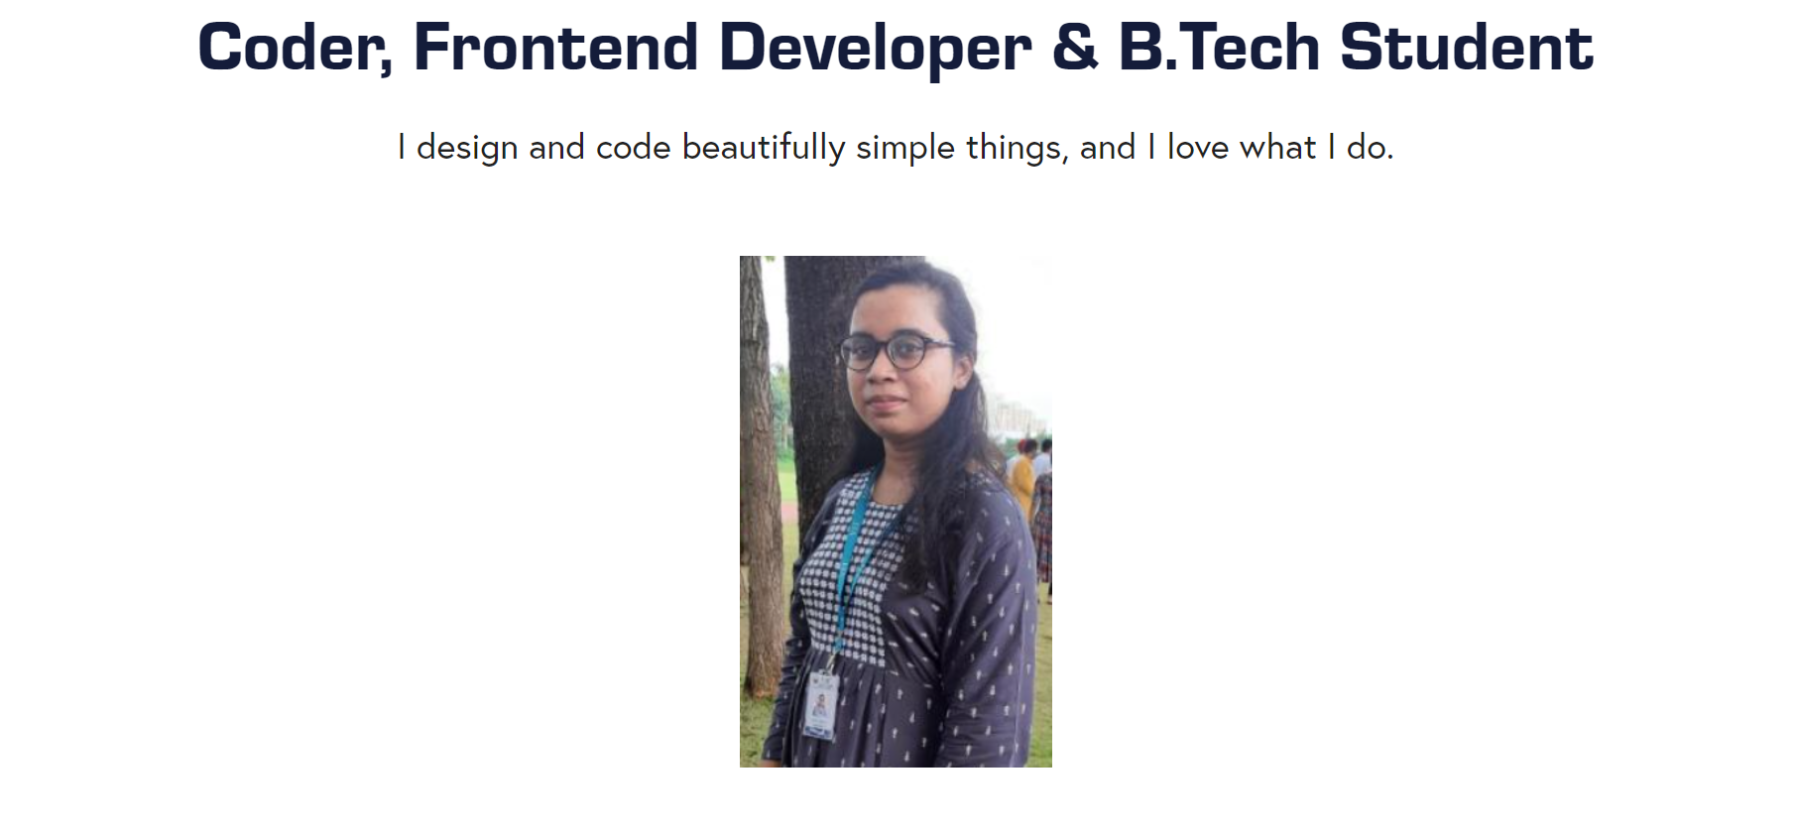
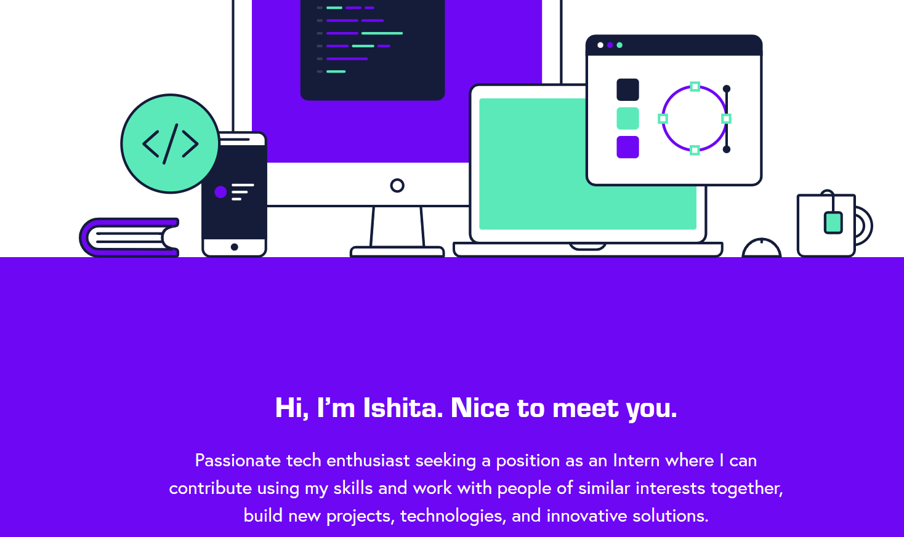
Portfolio Website

Slide 6
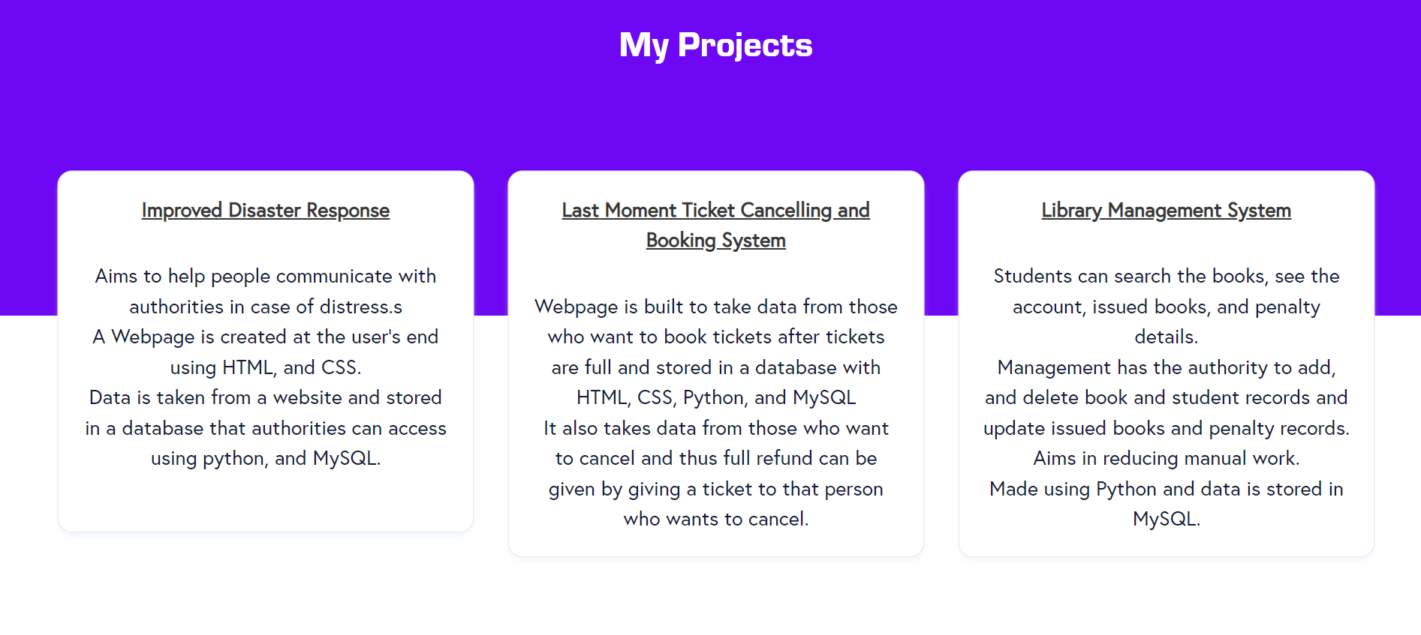

Slide 7
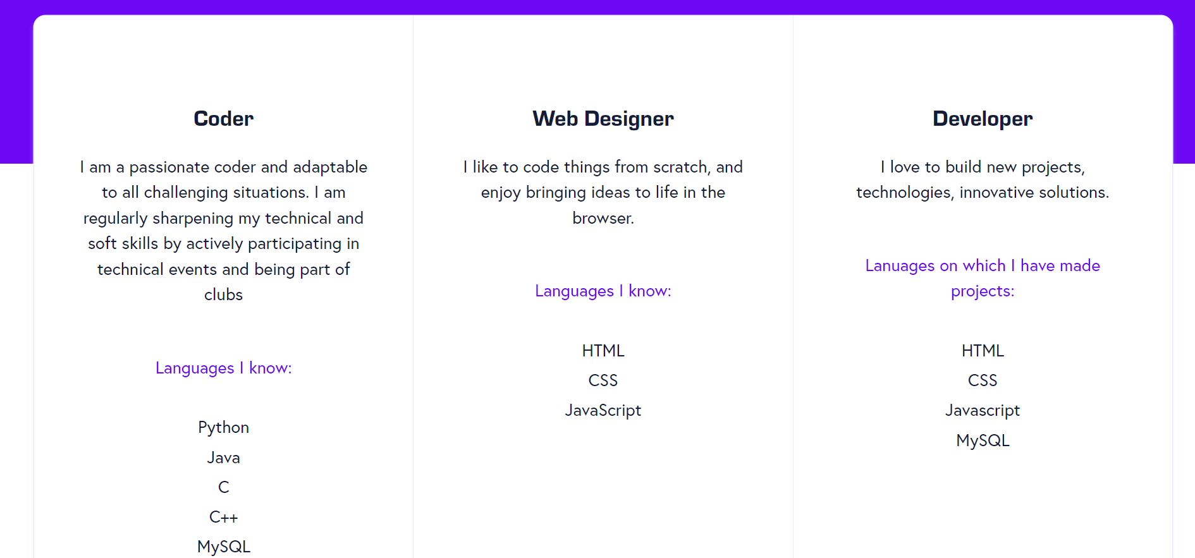
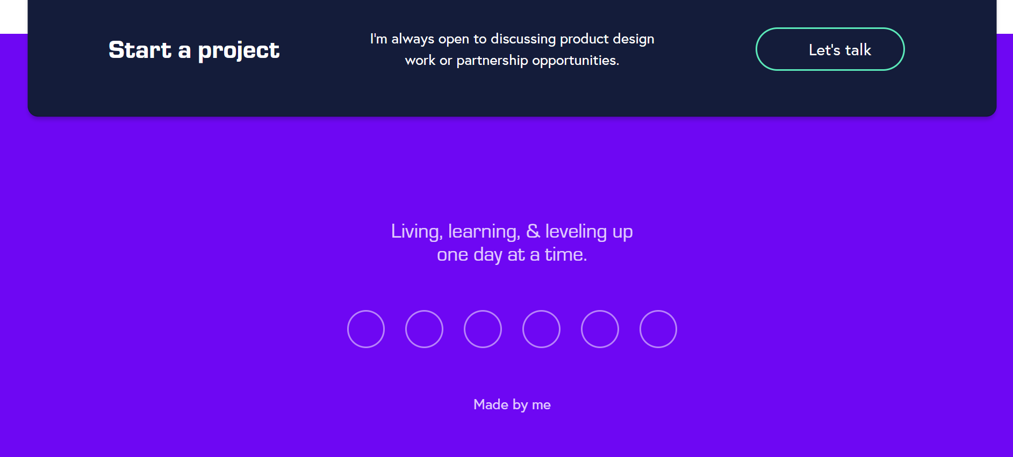
PORTFOLIO WEBSITE

Slide 8
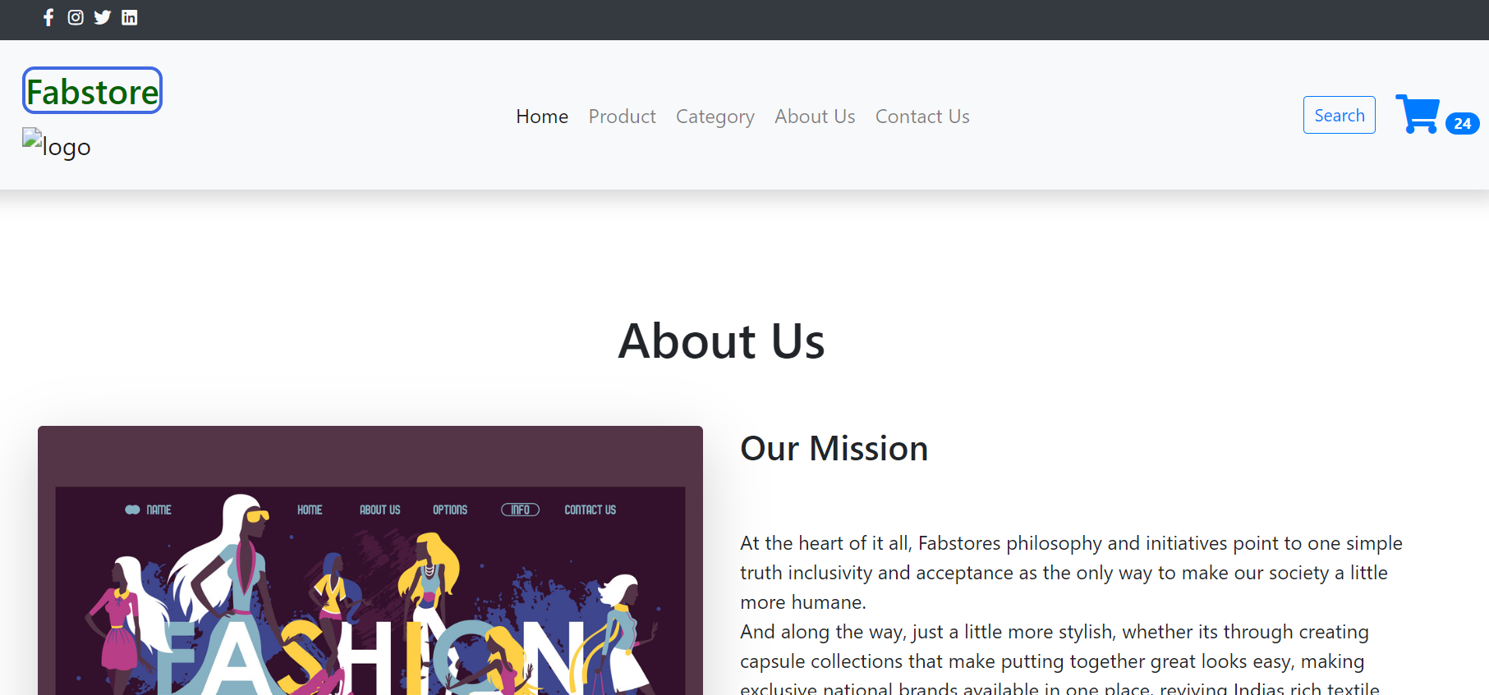
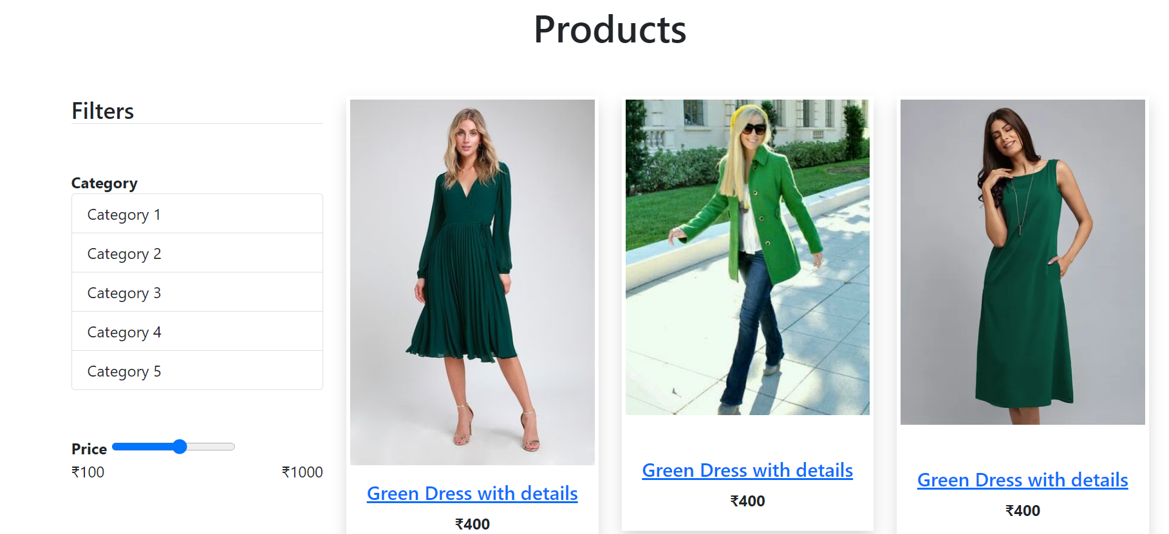
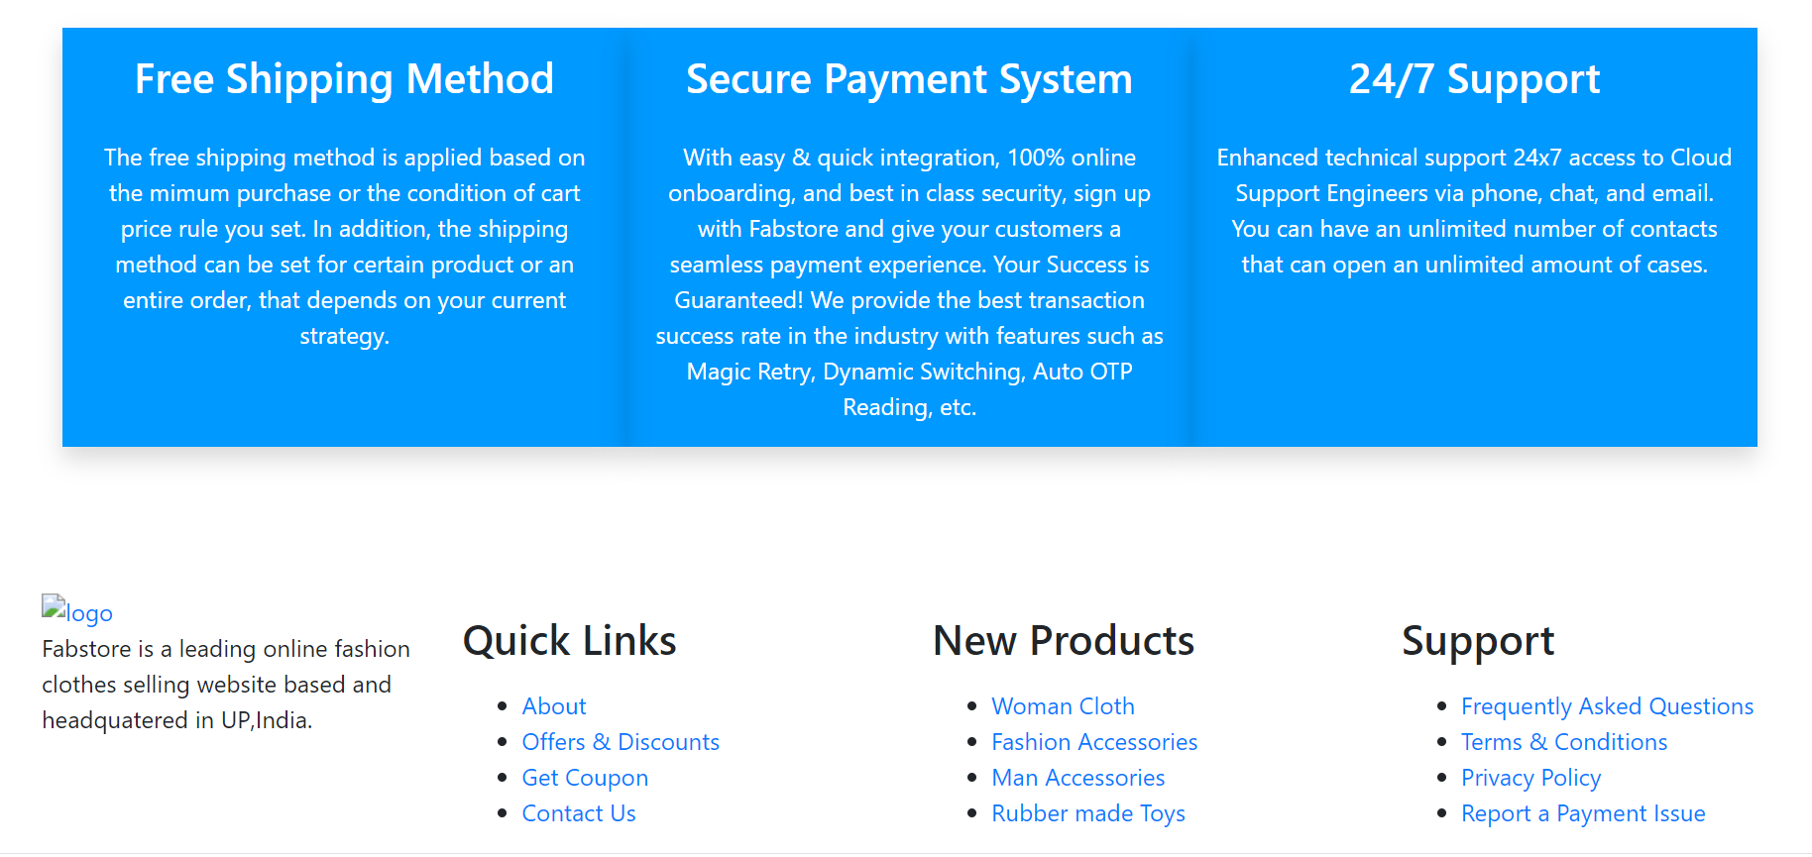
Shopping Website

